Slide 1


Noaa grb/hrit user group
Satellite Data and Imaging Enthusiasts
Carl G. Reinemann
https://usradioguy.com
March 15, 2023

Slide 2
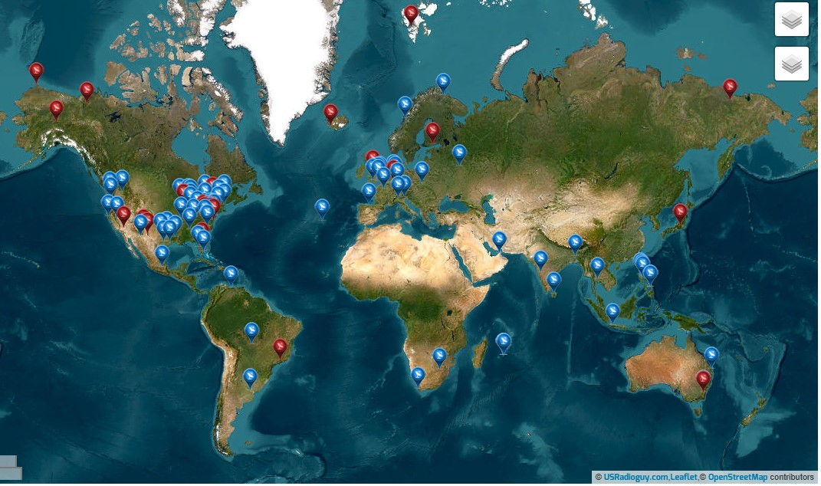

Guides, Builds
  USRadioguy https://usradioguy.com/
  A minimal LRIT/HRIT receiver https://pietern.github.io/goestools/guides/minimal_receiver.html
  RTL-SDR.com Comprehensive Tutorial https://www.rtl-sdr.com/rtl-sdr-com-goes-16-17-and-gk-2a-weather-satellite-reception-comprehensive-tutorial/
  Open Satellite Project https://osp.teske.net.br/channel/opensateliteproject
User Groups and Forums
  Geo Stationary Satellite Group https://www.facebook.com/groups/gswsg Facebook Group for Geo Stationary Weather Satellites
  GOESTools Users https://groups.google.com/g/goestools-users A smaller group for people who use the software Goestools
  GEO-Subscribers https://groups.io/g/GEO-Subscribers The official group is for subscribers of the Group for Earth Observation (GEO)
  Amateur Satellite Group on Reddit https://www.reddit.com/r/amateursatellites/ A subreddit dedicated to artificial satellites
Map of Satellite Data and Imaging Enthusiasts
https://usradioguy.com/ground-station-map/

Slide 3
Software
  Goestools https://github.com/pietern/goestools Tools to work with signals and files from GOES satellites.
  SATDUMP https://github.com/altillimity/ A multi satellite decoder and image processor.
  GK-2A Decoder https://github.com/sam210723/xrit-rx LRIT/HRIT Downlink Processor for GK-2A
  Sanchez https://github.com/nullpainter/sanchez Designed for processing of greyscale IR images from geostationary satellites, can also be used to reproject full color images.
  Vitality GOES https://github.com/JVital2013/vitality-goes A Web App for showcasing Geostationary Weather Satellite Data.
  Raydel XRIT Decoder http://www.geo-web.org.uk/XRITDecoder.php A software solution for decoding and extracting files from GOES LRIT/HRIT streams
  XRIT Decoder for GOES https://usa-satcom.com/ XRIT Decoder (HRIT from GOES on L-Band), XView, WX Sandwich Maker
  GRB Play https://usa-satcom.com/ Processes NetCDF files for GOES GRB SUVI, does animations, Electron and X-Ray flux as well
  SUVI Play https://usa-satcom.com/ Displays and does animations with CSPP GEO images from GOES GRB
  GRB Streamer and Imager- Bret Casebolt
  CSPP Geo software https://cimss.ssec.wisc.edu/csppgeo/
  XRIT Decoder Open Satellite Project https://github.com/opensatelliteproject/xritdemod

Slide 4
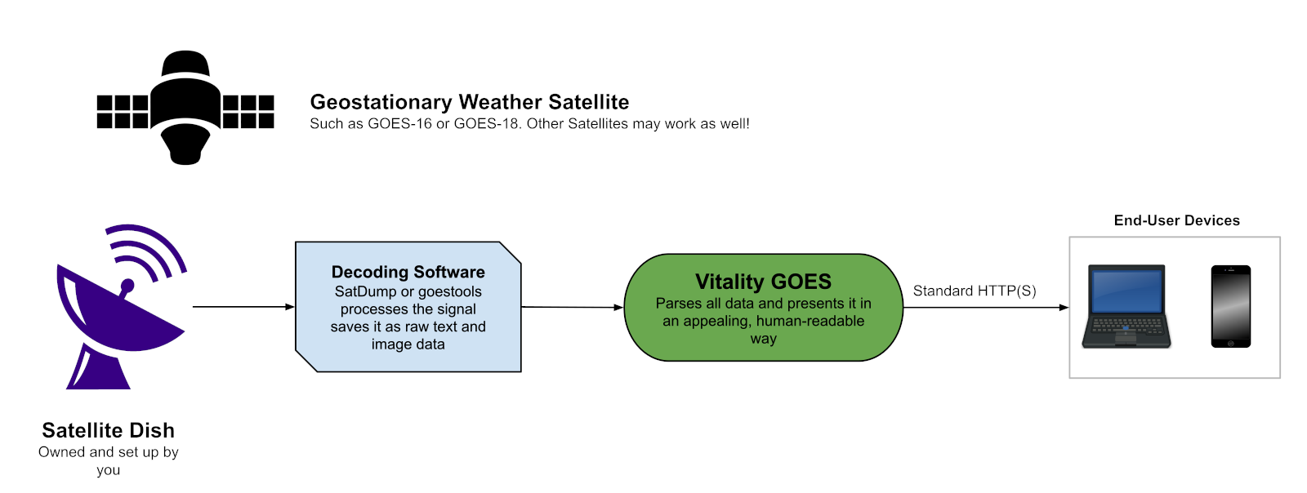
  Vitality GOES a new way to view Geo Satellite Imagery and Data
  What does Vitality GOES do?
  Vitality GOES makes data received from a Geostationary Weather Satellite feed easily accessible, through a web browser, from anywhere on your local network (or internet).
  The GOES HRIT/EMWIN downlink provides rich weather data, forecasts, and other information on the EMWIN virtual channels. This data is extremely useful to end users, but it's often encoded in a way that obscures its meaning - and it can be hard to find good documentation on reading the data. In addition, it will show Alerts: Weather Watch, Weather Warning; (Snow Squall, Fire Weather, Tornado Warning , etc.), Local Emergencies, Hurricane…
  Vitality GOES solves this by parsing the data and presenting pertinent information to you.

Slide 5
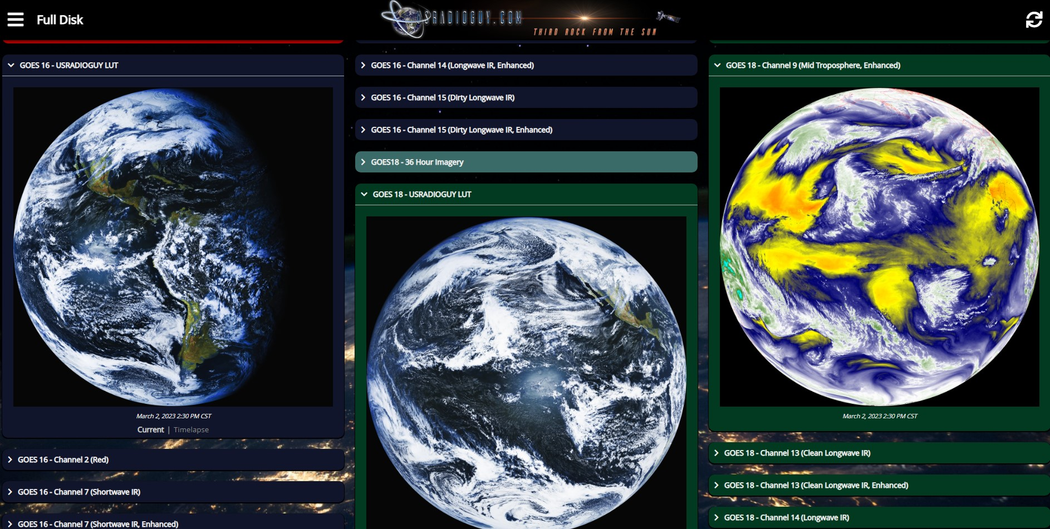

Slide 6
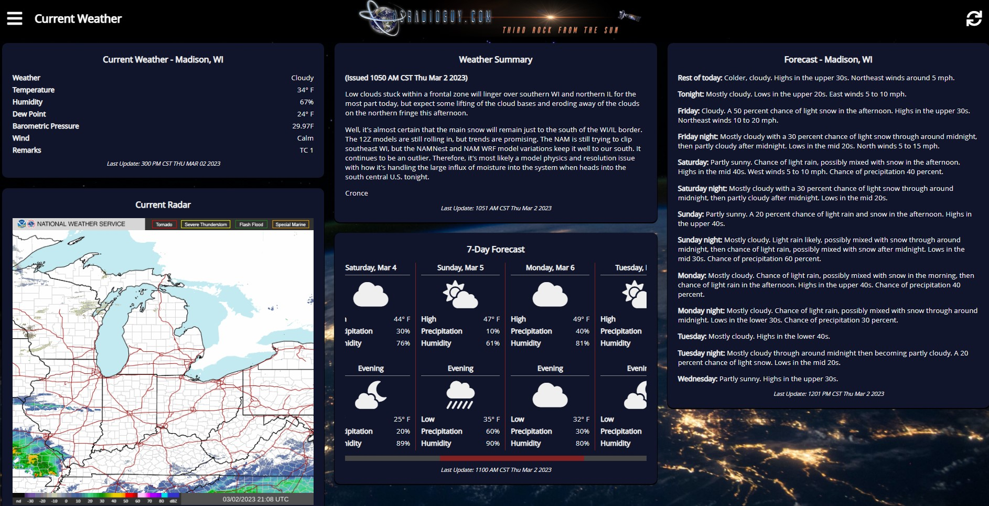

Slide 7
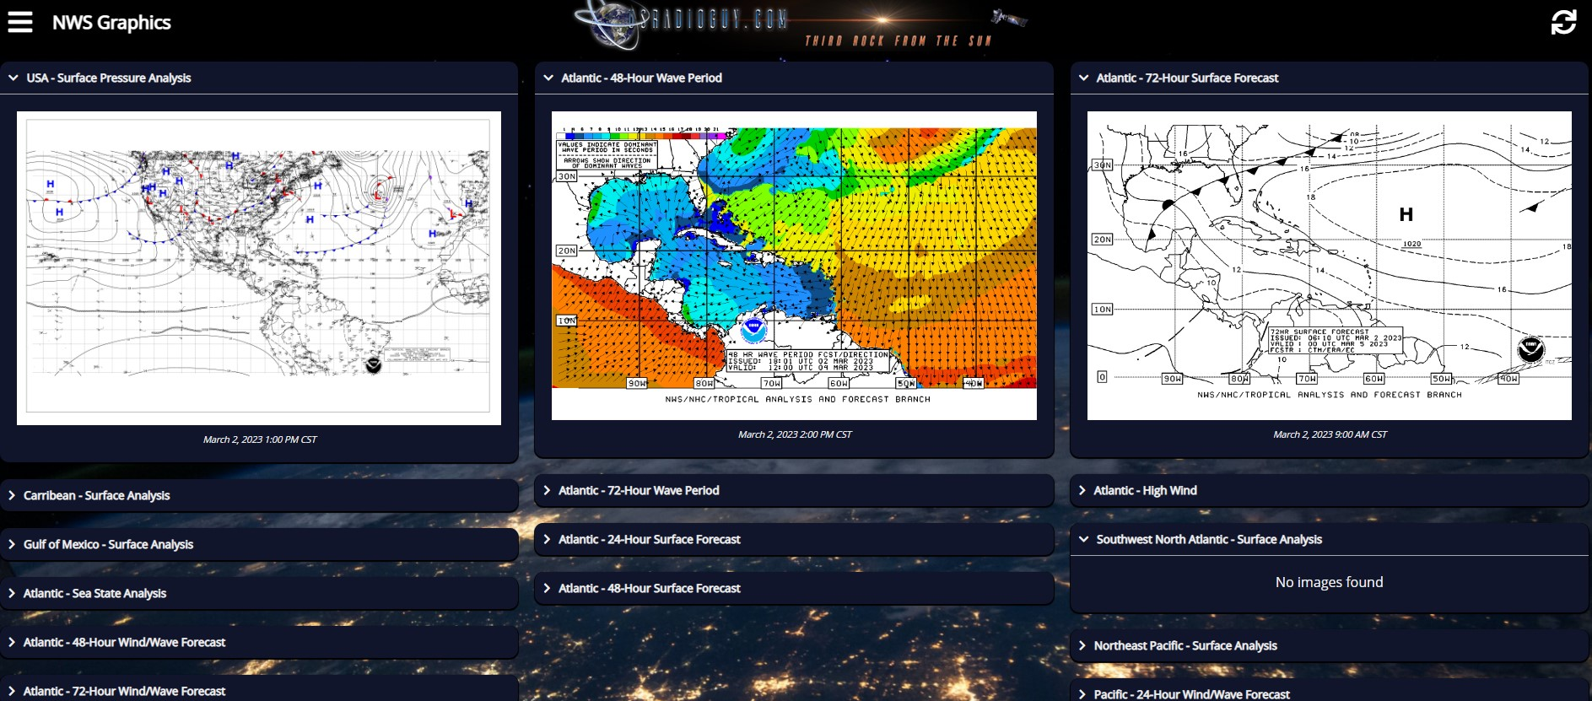

Slide 8
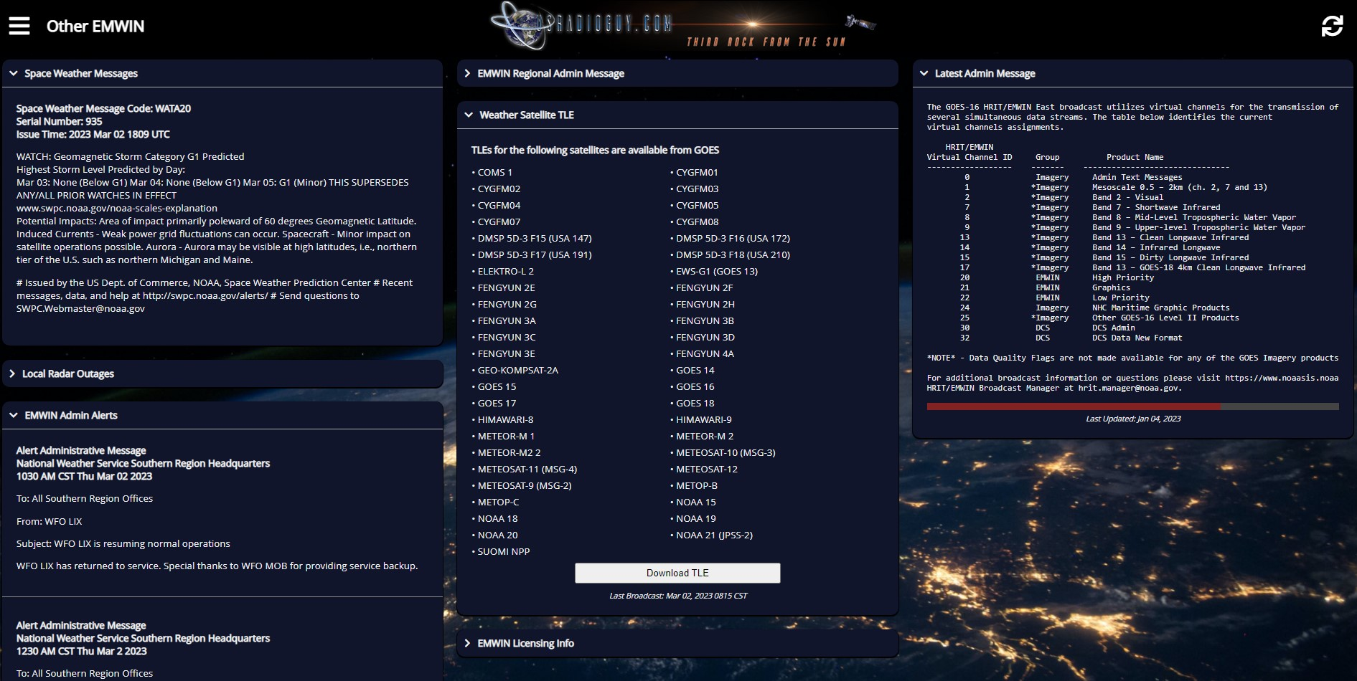

Slide 9
